Slide 1


Understanding phishing
attacks and social engineering.
CYBER SECURITY

Slide 2



“IN THE DIGITAL AGE, SECURITY IS NOT JUST PROTECTION—IT’S EMPOWERMENT.”
FRADEL AND SPIES CO

Slide 3

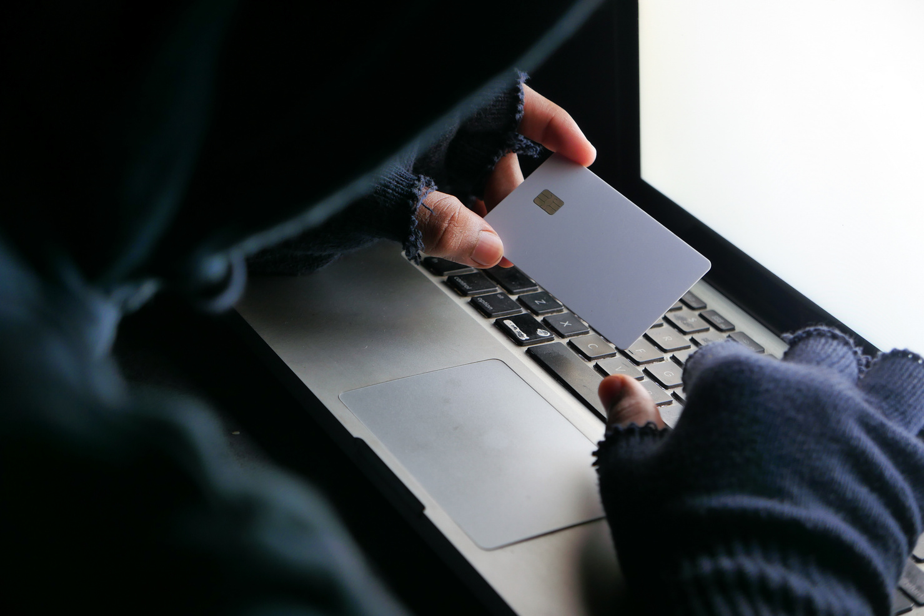
INTRODUCTION
Goal
Phishing
Modern phishing campaigns employ sophisticated techniques such as domain spoofing, email spoofing, URL manipulation, and generative AI to create convincing fraudulent communications that bypass traditional security filters
Phishing is a cyberattack method where attackers attempt to deceive users into revealing sensitive information or compromising security systems. Attacks have evolved from traditional email-based methods to include SMS, phone calls, and QR codes

Slide 4


Industry Sector | Attack percentage | Key Details
Financial Services | 23.6% | Most targeted sector globally
E-commerce | 14.6% | Second most targeted industry
Healthcare | High priority | Primary hacking technique for sector penetration
Known phishing websites | 611,877+ | Currently active on the internet
Kaspersky blocked attempts (2025) | 554 million | Fraudulent link access attempts blocked
INDUSTRY
GLOBAL
STATISTICS

Slide 5


RECOGNIZING PHISHING EMAILS AND FAKE WEBSITES
Key Red Flags in Phishing Emails
Urgent call to action or threats
Mismatched URLs
Messages demanding immediate clicks or claiming account compromise create false urgency, a common phishing tactic
Hover over links to verify they match the claimed sender's legitimate domain
Requests for sensitive data
Suspicious sender information
Legitimate organizations never request passwords, credit card numbers, or personal information via email
Emails from unknown senders or those flagged by Outlook/Teams as new senders warrant careful examination
FRADEL AND SPIES CO

Slide 6
SOCIAL ENGINEERING TACTICS AND ATTACK VECTORS
Modern Attack Methodologies
Account takeover campaigns
AI-generated deepfakes
Credentials stolen to gain unauthorized access to corporate systems and sensitive data
Synthetic video/audio of executives convincing employees to transfer funds (Hong Kong case: $25 million unauthorized transfer)
Supply chain targeting
Business Email Compromise (BEC)
Attacks exploiting vendor relationships and trusted infrastructure to bypass security filters
Targeted attacks impersonating executives to authorize fraudulent transactions
FRADEL AND SPIES CO

Slide 7
Attack Evolution | Previous Approach | Impact | Current Approach
Attack Scale | Mass campaigns | Higher success rates | Targeted precision attacks
Technology Integration | Text-based deception | More convincing and harder to detect | AI deepfakes + biometric theft
Regional Customization | Generic templates | Increased relevance and credibility | Localized fraud schemes
Platform Diversity | Email-focused | Broader attack surface | Messaging apps, QR codes, voice calls
EMERGING ATTACK TRENDS IN 2025

Slide 8

BEST PRACTICES FOR INDIVIDUALS
Use strong, unique passwords
Avoid suspicious links/emails
Enable 2FA whenever possible
Regularly update devices
Back up important data

Slide 9
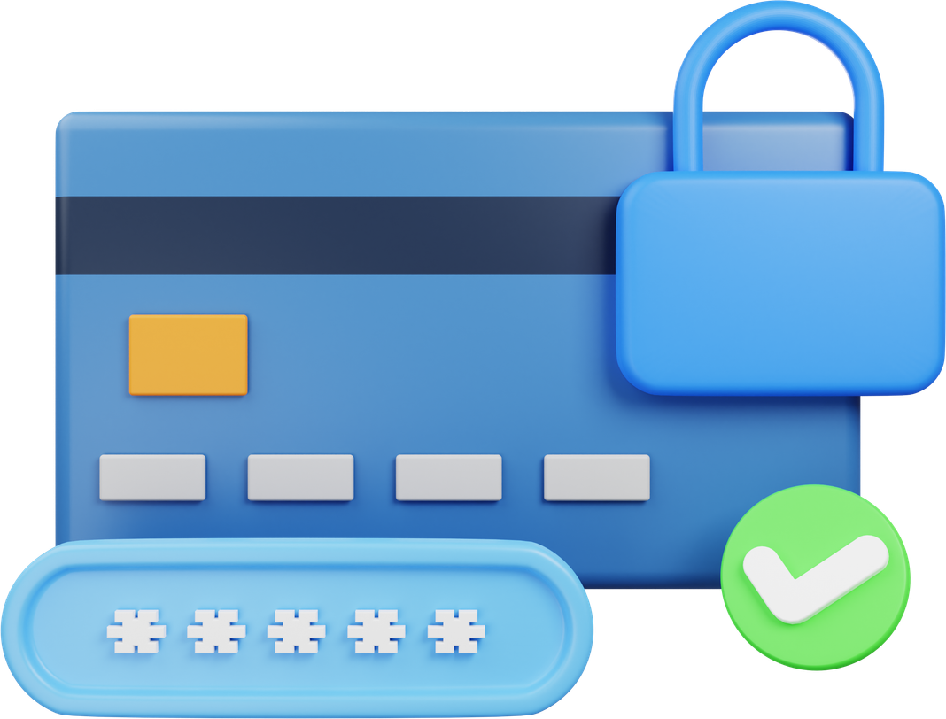
BEST PRACTICES AND DEFENSE STRATEGIES
Firewalls and antivirus software
Encryption of sensitive data
Multi-factor authentication (MFA)
Regular software updates and patches
Security audits and penetration testing

Slide 10



ORGANIZATIONAL SECURITY FRAMEWORK
FRADEL AND SPIES CO
Organizations should implement multi-layered defenses including advanced email filtering with AI detection, user authentication protocols, regular security awareness training, incident response procedures, and phishing simulation programs to test employee preparedness

Slide 11


ATTACK TECHNIQUE EXAMPLES
Credential Harvesting Methods
Business Email Compromise (BEC)
Attackers create convincing replicas of login pages for banks, email services, and social platforms, collecting usernames and passwords through fake account verification prompts or password reset pages.
Fraudsters research company hierarchies and business relationships, then impersonate executives to authorize wire transfers, demanding urgency to bypass verification procedures.

Slide 12

THANK YOU
Stay informed and proactive
Cyber security is everyone’s responsibility

